Slide 1
LEADERSHIP STYLES
IFHOHYP STS21. July 9th 2021 -- Day 5.
Created and Presented by Nicole Leung, Kevin Weiser, and Maria Skoczyńska.

Slide 2
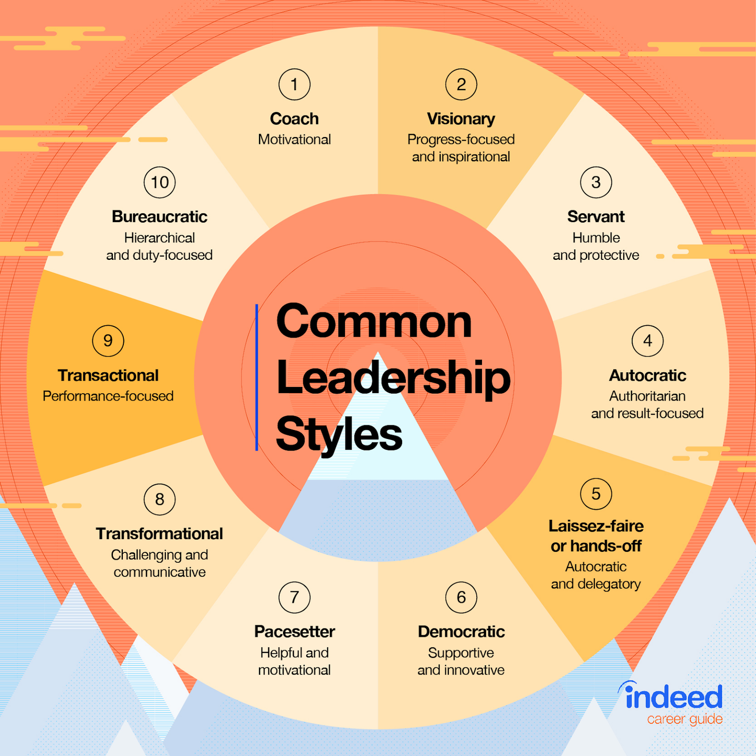

Slide 3
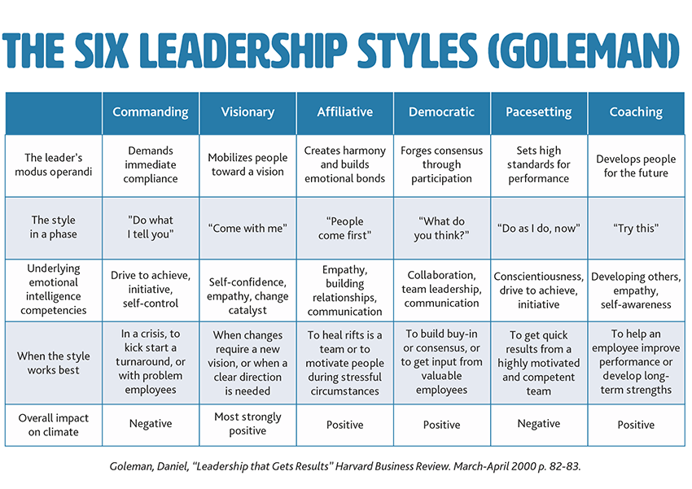
Notes:
mo·dus op·e·ran·di
a particular way or method of doing something, especially one that is characteristic or well-established.

Slide 4
QUESTIONS
IF YOU WANT TO BE A BETTER LEADER, WHAT WOULD YOU NEED TO WORK ON?
WHAT TYPE OF A LEADER DO YOU THINK HE/SHE IS AND WHY? -> SEE PICTURES ON NEXT SLIDES
WHAT KIND OF LEADERSHIP STYLE DO YOU HAVE?

Slide 5
GROUP 1
Malala Yousafzai

Slide 6
GROUP 2
Donald
Trump

Slide 7
GROUP 3
Angela
Merkel

Slide 8
GROUP 4
Martin Luther
King

Slide 9
GROUP 5
Kamala
Harris

