Slide 1
STRENGTHS
&
WEAKNESSES
IFHOHYP Study Session 2021
Created and Presented by Nicole Leung and Maria Skoczyńska

Slide 2
HOW TO TRANSFORM YOUR WEAKNESS INTO YOUR STRENGTH?

Slide 3
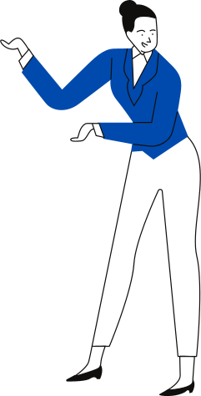
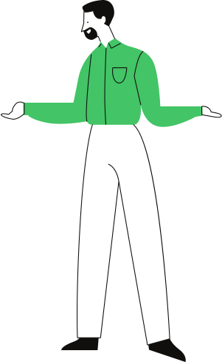
I have troubles following group discussion
but I pay more attention to what is being said if one person speaks at one time

Slide 4
but I'm superfast in typing messages!
I can't make phone call

Slide 5
Weakness
Strategy

Slide 6
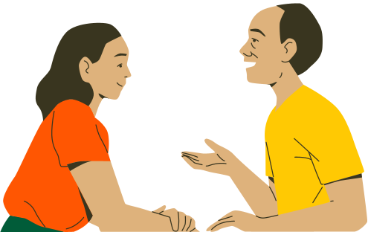
YOU'RE GOING FOR A JOB INTERVIEW FOR A POSITION
OF A MANAGER.
HOW DO YOU CONVINCE YOUR POTENTIAL BOSS THAT YOU'RE THE BEST FOR THIS JOB EVEN WITH YOUR HEARING LOSS?

Slide 7
YOU'RE GOING TO SPEAK AT A FORUM FOR DISABILITY RIGHTS.
YOU'RE AFRAID TO BE DISCRIMINATED AGAINST WHEN YOU CANNOT HEAR OR SOMEONE CANNOT UNDERSTAND YOU.

Slide 8
Fear of not being able to hear everyone as a leader
Public speaking as a HOH leader
Thinking on the spot: How I manage?
Perfectionist mindset: I need to know everything if I am leader; this is important only I know how to do it properly

Slide 9
Limiting Beliefs:
I am victim of circumstance.
Life happens to me.
I live in scarcity, there's never enough.
Obstacles hold me back.
I can't start until _____ happens.
This is too hard, I should quit.
Empowering Beliefs:
I create my own reality.
Life happens for me.
I live in abundance, there's always enough.
Obstacles help me grow.
Starting before, I'm ready leads to success.
If it were easy, everyone would do it.

Slide 10
Connect with other leaders. Share your challenges. Return the favor and support each other.

