Slide 1

the art of
NETWORKING
IFHOHYP STUDY SESSION 2021
CREATED AND PRESENTED BY KAVE NORI.

Slide 2

EVERYONE DOES IT BUT WHAT IT IS?

Slide 3

Many people believe that networking means calling everyone and asking them for a job. However networking is a two way street: it is a way of getting to know someone better and finding ways they might be able to help you and how you can help them in return.A professional networking event is a great opportunity to present yourself, make new connections and even find yourself a new job.
To become a successful networker, you should follow the belief that everyone has something to learn and gain.

Slide 4

HOW TO NETWORK?

Slide 5

01
02
be open to meet
PEOPLE
ask for
ADVICE
meet them through your friends, acquaintances etc. Seek out like-minded or key contacts you would like to know better within your LinkedIn profile, Google Plus, Twitter and more.
Try commenting on a link they post or responding to a comment they make, start a conversation with them and offer them value in return.
When you establish relationship, ask second person for advice, what can you improve. Also, you can ask your contacts if they can recommend a professional organisation or the names of some of the people you should be talking with.

Slide 6
03
04
be
CONCISE
LISTEN!
Don't take too much of time of person you speak to, unless you want to bore her/him to death! By planning what do you want to present you can show your professional approach. (Applicable in the case if you want to present your idea for e.g. social campaign).
When networking, be sure that you don’t do all the talking. The key to being a good conversationalist is being a good listener. Ask questions about this person too. It will help you to get someone to know better and to recognize what you can do with her/him.

Slide 7
06
05
don't forget to say
FOLLOW UP
THANK YOU
If you want to establish rapport with another person, create a reason to keep the relationship going. If you read an article that adds to a discussion you had during a networking meeting, save it and send it to them with a brief note on what you found interesting and how you think it could benefit them.
Thank your connection for the information they have given and see if you can help them in any way. Share any knowledge you feel would be useful for them. Keep notes on what you learn.

Slide 8
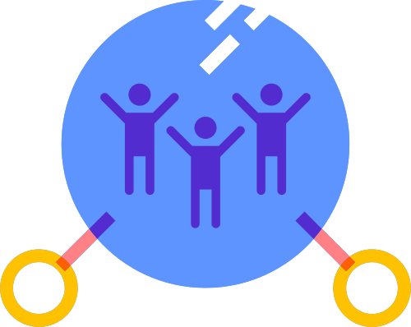
GET OUT THERE AND MEET PEOPLE!
...unless we live in covid times...

