Slide 1
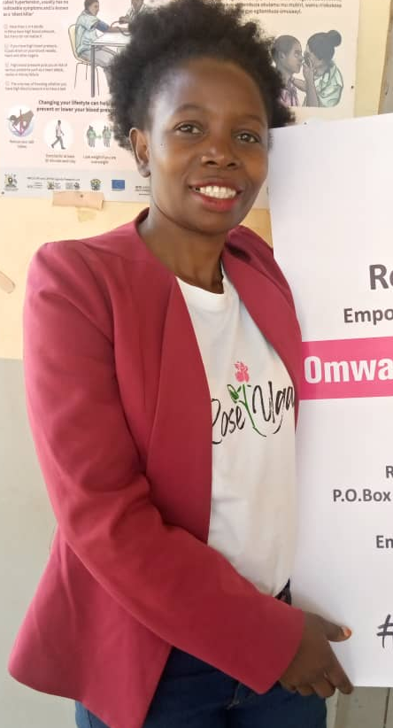

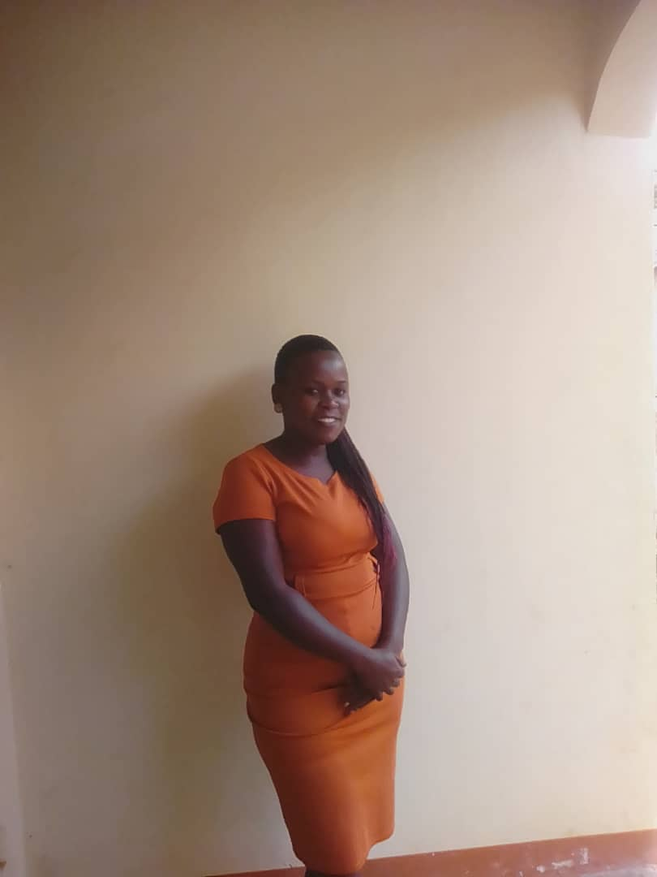
Capacity building:
Presentation by: Nalubwama Mastulah & Hellen Birungi:
Executive Director: Uganda Federation of the Hard of Hearing. (UFHOH) UFHOH Member Central Region
Rep. East Africa: African Federation of the Hard of Hearing. (AFHOH) Advocate for Children with disabilities at
Study Session Committee Member: (IFHOHYP) CBO/Initiative for Peace and Development
Fellow: Rose Uganda

Slide 2
Capacity building:
Capacity-building is defined as the process of developing and strengthening the skills, instincts, abilities, processes and resources that organizations and communities need to survive, adapt, and thrive in a fast-changing world.

Slide 3
What are the elements of capacity building?
FIVE ELEMENTS FOR SUCCESS IN CAPACITY BUILDING
Commit for the long term.
Co-create solutions with stakeholders.
Strengthen the ecosystem.
Support both technical and adaptive capacities.
Ground capacity building in equity.

Slide 4
Themes contributing to capacity-building
UFHOH
International level:
Membership and networking World hearing Forum, International Federation of Hard of Hearing (IFHOH).
, International Federation of Hard of Hearing Young people (IFHOHYP).
Country level:
Lobbying for mainstream programs in the office of gender and social development memorandum of understanding developed
Regional level:
Establishment of robust structure through which members are mobilized from grassroots levels (HOHERA, HOHCRA,HOHSWRA,HOHNRA)
Institutional level:
Internal Training UFHOH secretariat strengthened in Policy advocacy, Monitoring and evaluation etc
Individual level: Growth in knowledge and skills in Governance, Resource mobilization of HoH members

Slide 5
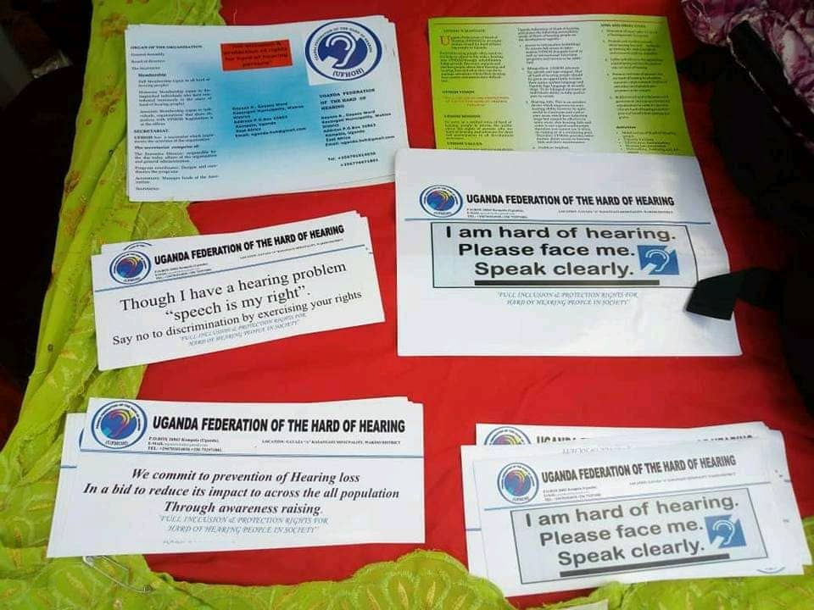
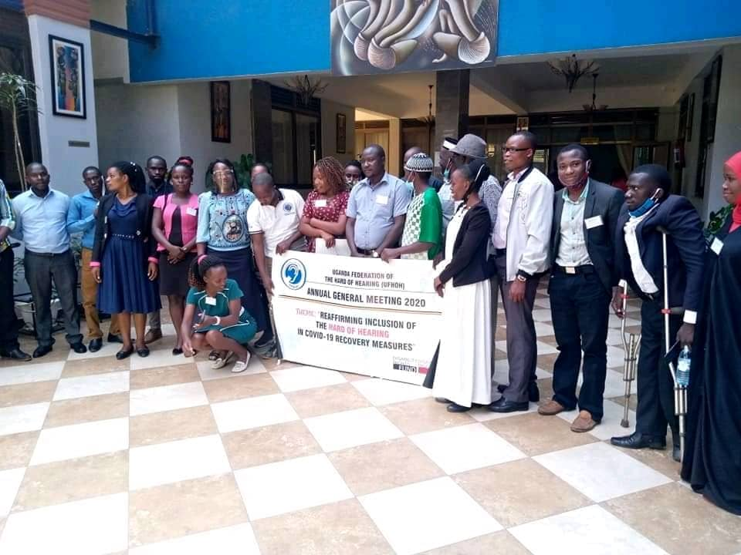
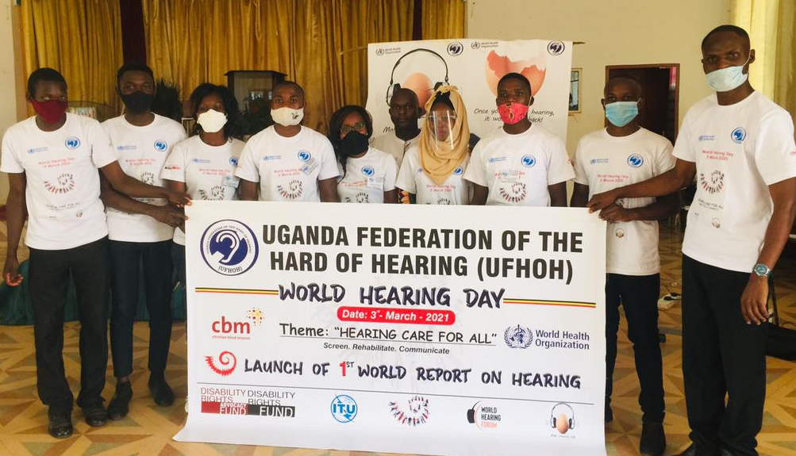
INDIVIDUAL LEVEL

Slide 6
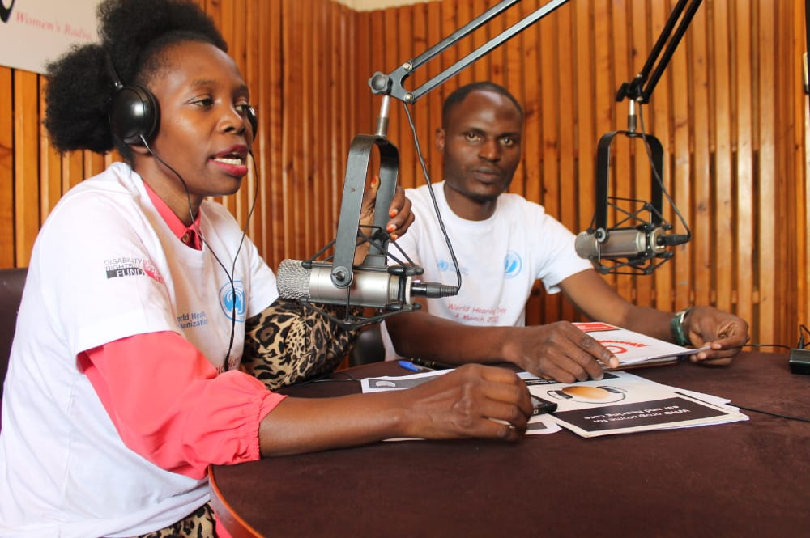
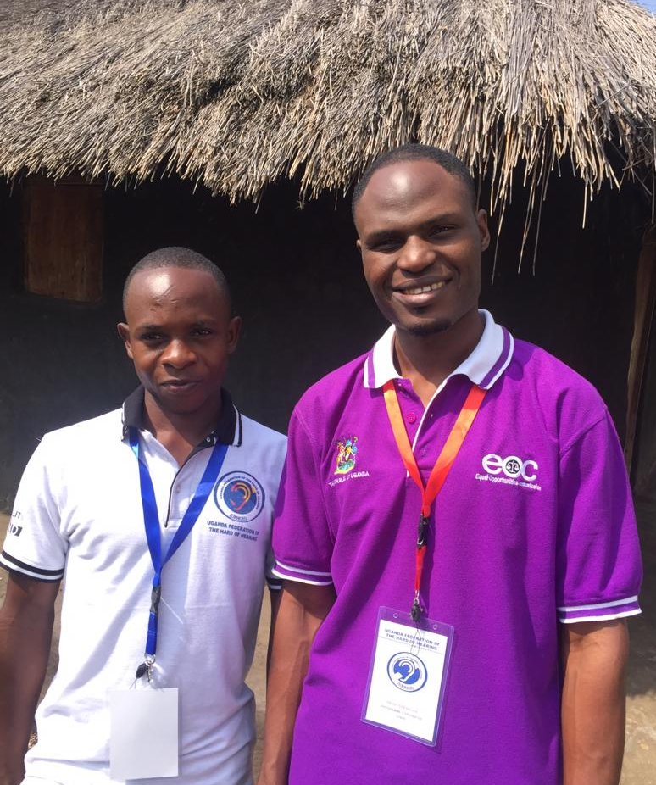
INSTITUTIONAL LEVEL

Slide 7
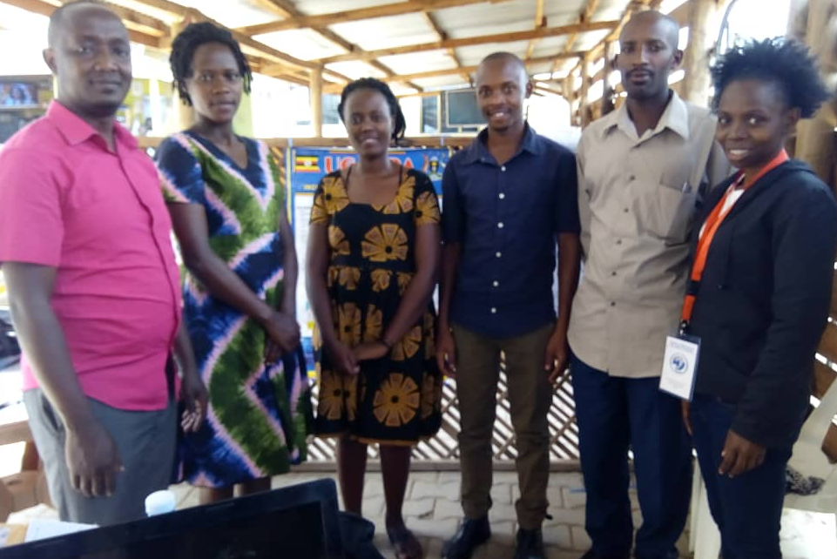
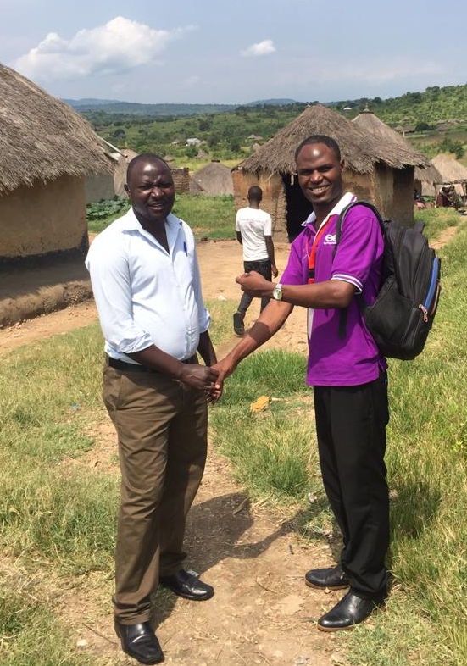
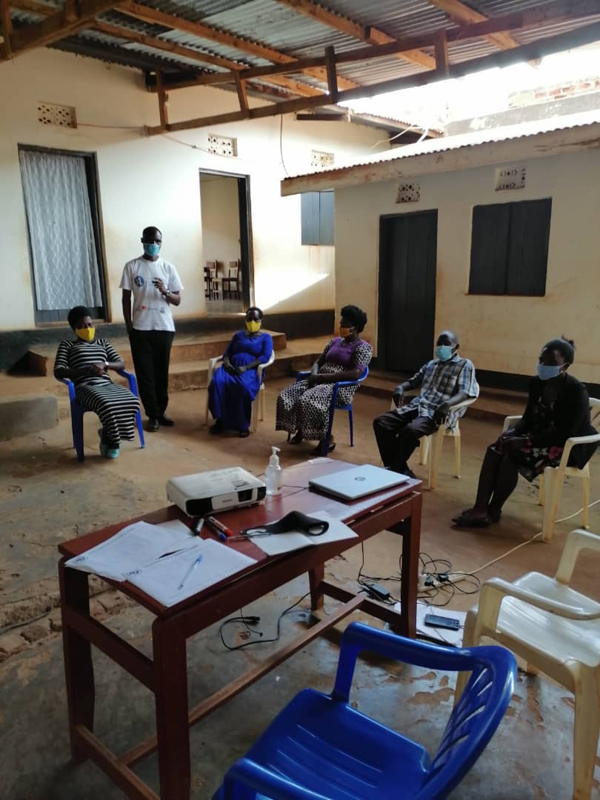
REGIONAL LEVEL: HOHERA, HOHCRAH, HOHSWRA, HOHNRA

Slide 8
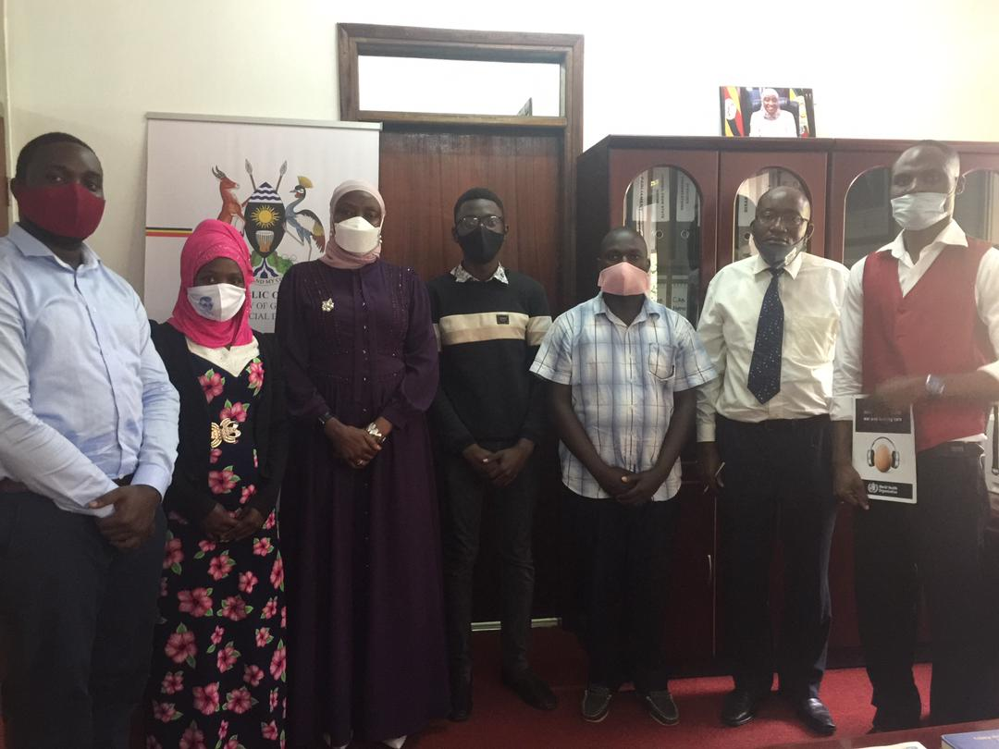
COUNTRY LEVEL

Slide 9
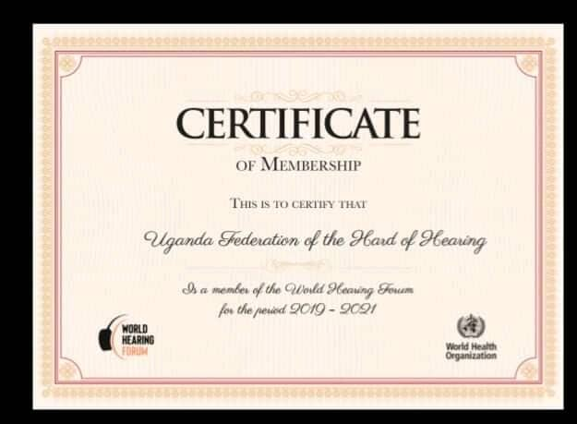

INTERNATIONAL LEVEL

